Slide 1
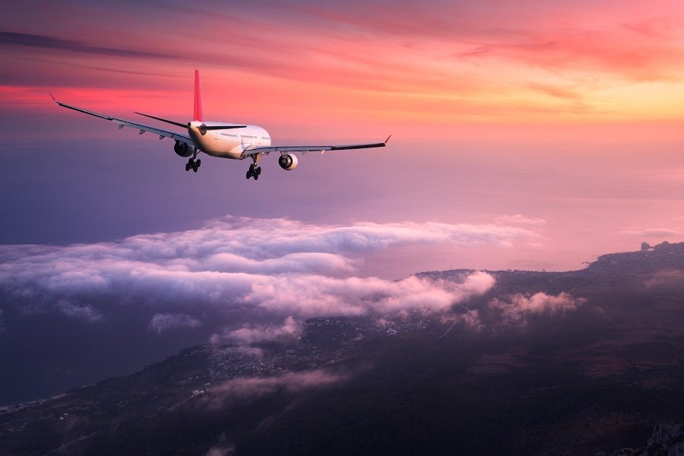
Project Topic: Airline Reservation System
By:
Iffat Sybin Anika, 1710067
Bhuiyan Shadman Wasif, 1710588

Slide 2
Contents:
Project Goals
A brief History
Features
UI
Let’s go to the Website now!

Slide 3
Project Goals
simpler for passengers to adjust their trips.
Decrease number of empty seats
It should store Passenger information in case of an emergency such as flight cancellation
Design and Implement the web-based airline information system.
Check and validate the system.

Slide 4
A brief History
Everything was very time consuming.
In 1946 the American Airlines was the first one to start an automated Airline reservation system.
It was very efficient and that’s how it begun

Slide 5
Features
The system will reschedule the tickets and the flights.
The system will reserve tickets
The system will book flights
The system will give option to select seat if the flight offers.
The system will allow to check flight status
The system will give option to print ticket
The system will cancel flights if required
The system will send email confirmation upon successful flight booking

Slide 6
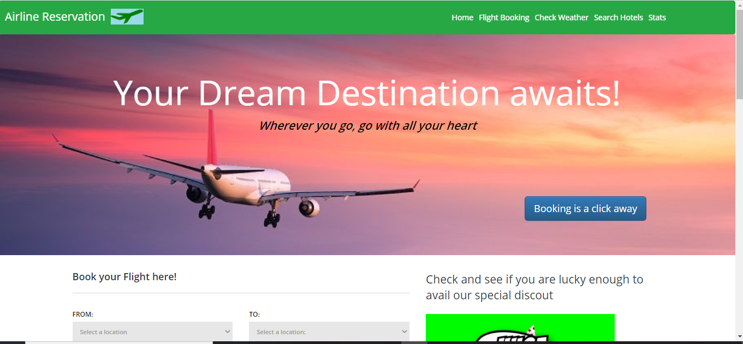
UI

Slide 7
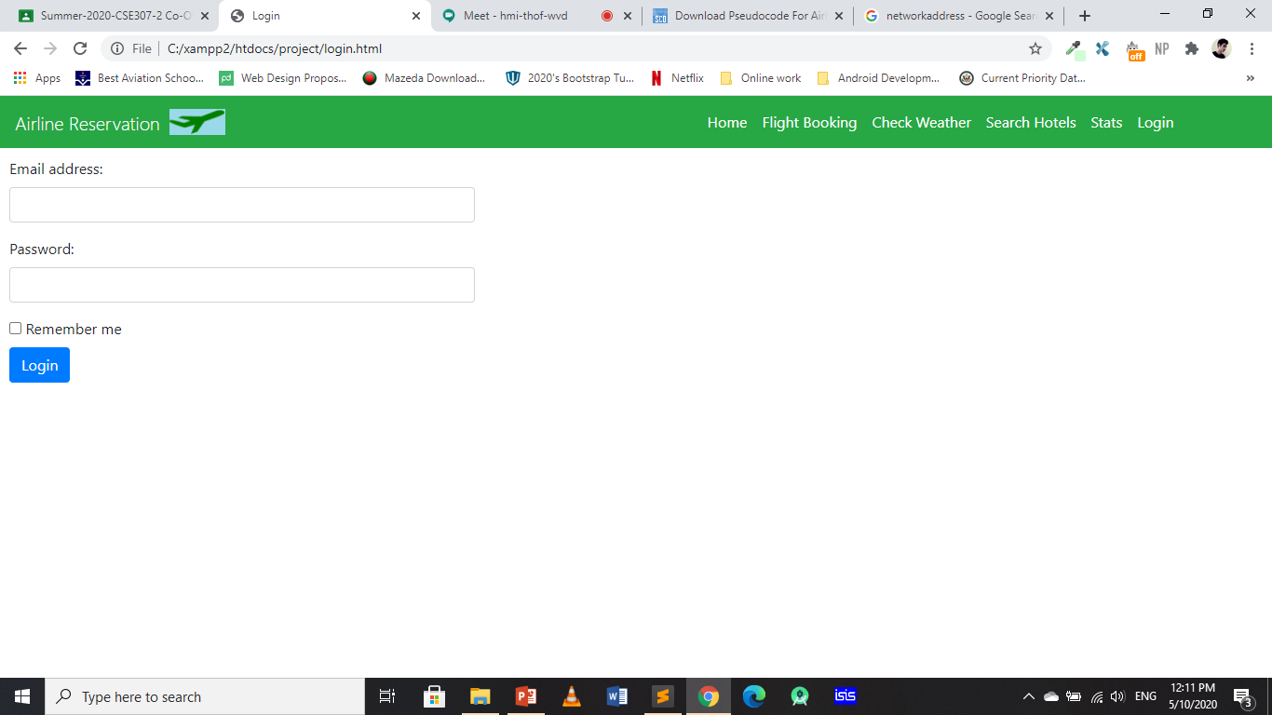

Slide 8
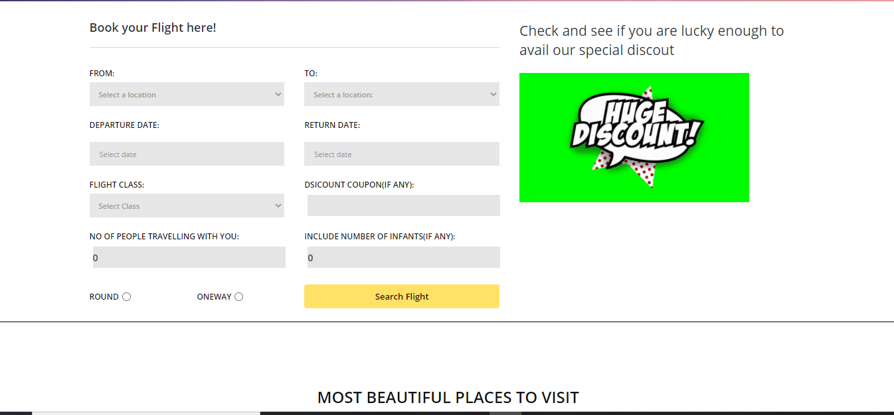

Slide 9
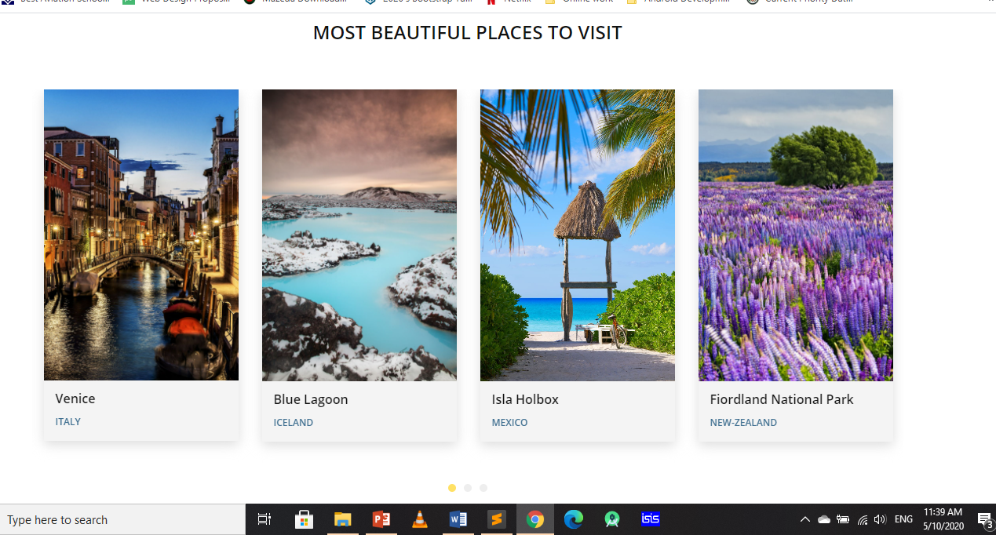

Slide 10
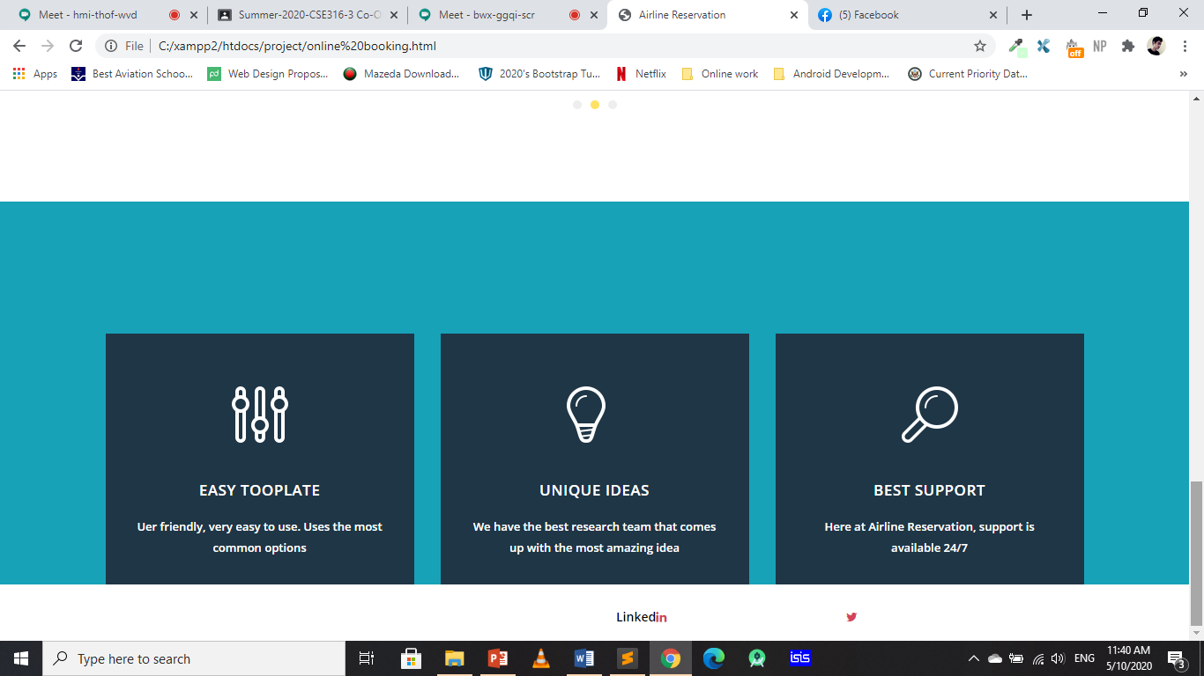

Slide 11
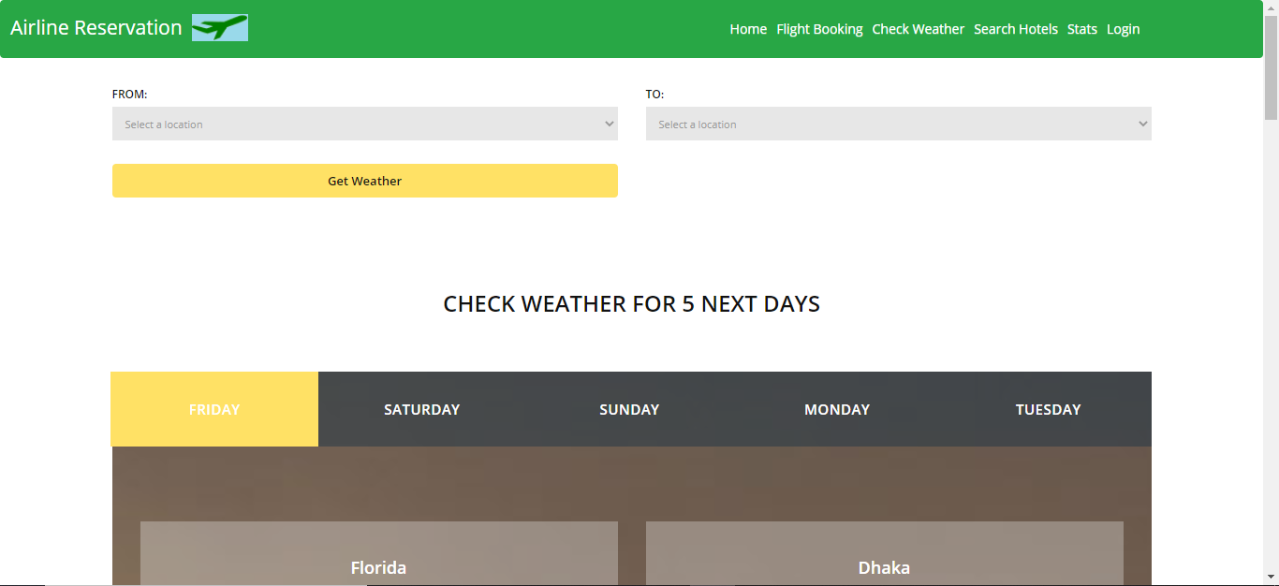

Slide 12
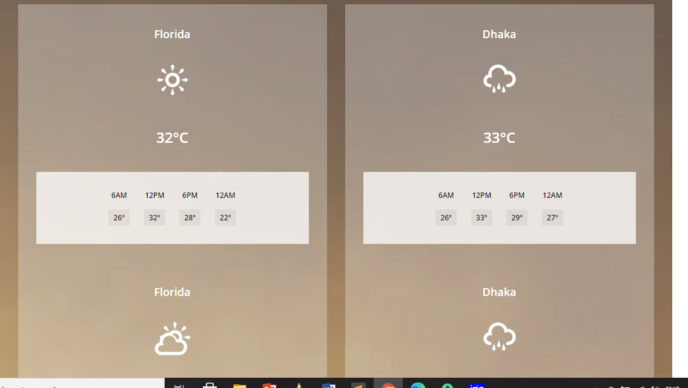

Slide 13
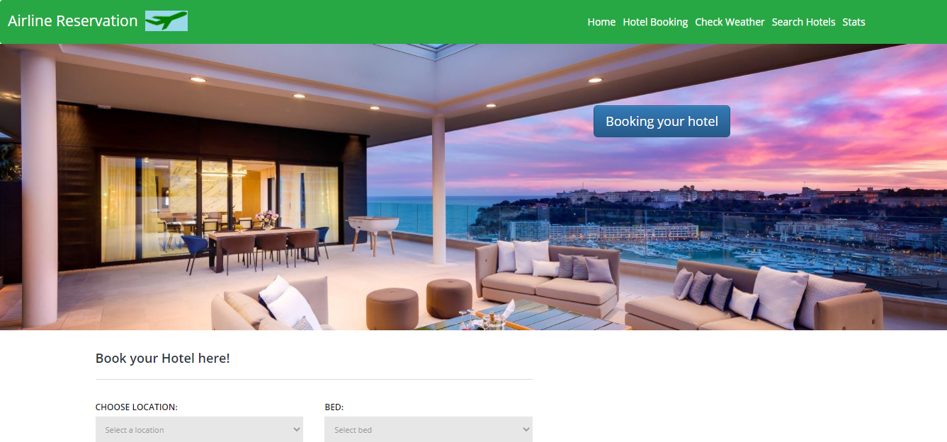

Slide 14
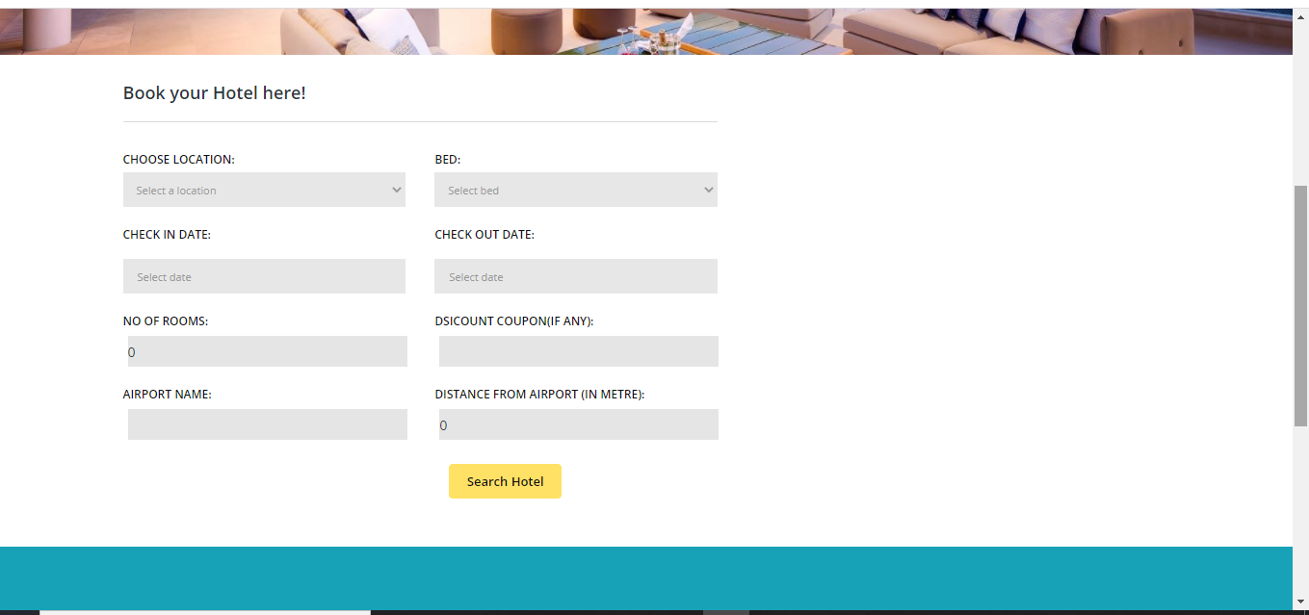

Slide 15
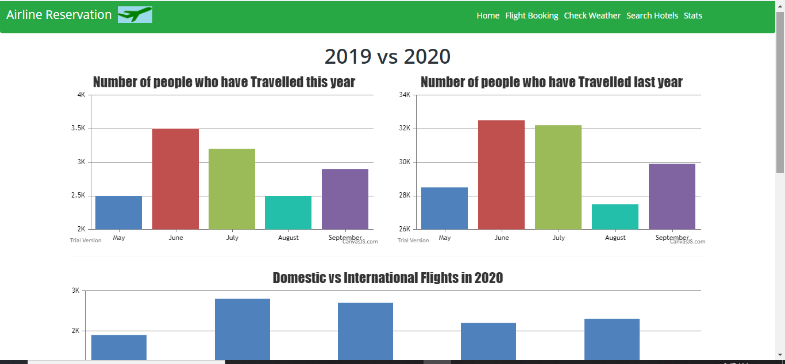

Slide 16
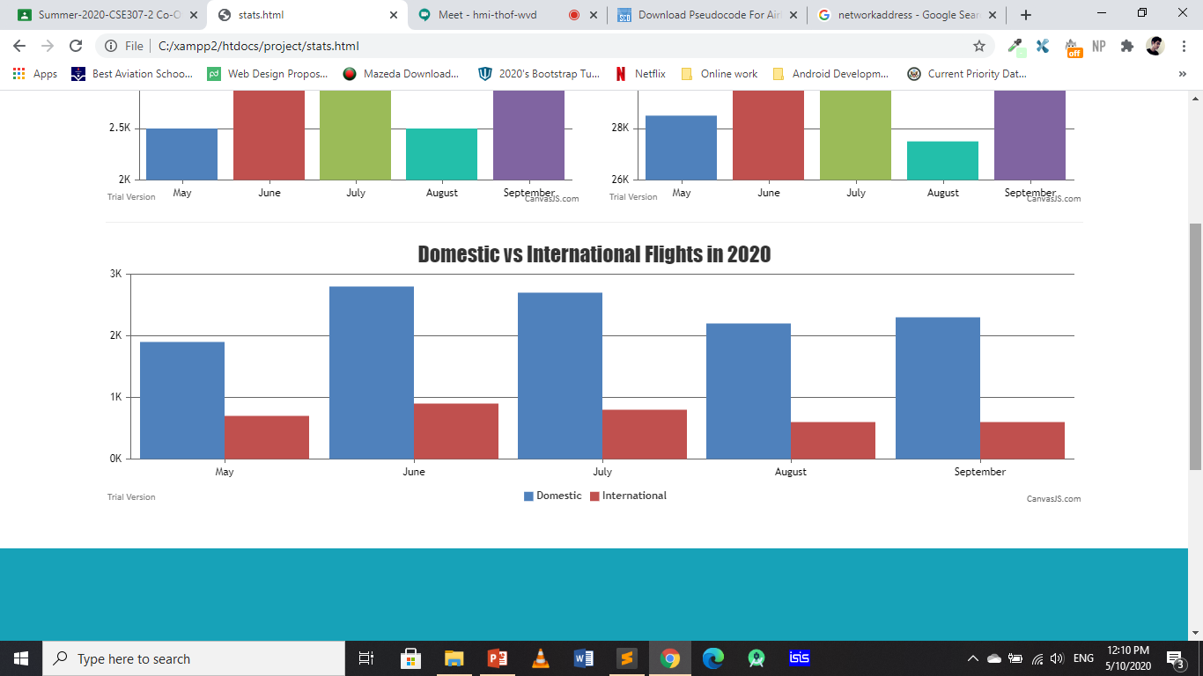

Slide 17
Let’s go to the Website now!

